Slide 1
Are We Serving the Children Who Need Us?
Grade | Enrollment | % students of color | % Males / Females | % FRM | % ELL | % Special Ed
K | 105 | 100% | 47%/53% | 100% | 0 | 10%
1 | 106 | 100% | 46%/54% | 96% | 0 | 12%
2 | 106 | 100% | 48%/52% | 97% | 0 | 8%
5 | 173 | 100% | 57%/43% | 91% | 0 | 9%
6 | 89 | 100% | 55%/55% | 96% | 0 | 16%
7 | 88 | 100% | 49%/51% | 93% | 0 | 11%
8 | 82 | 100% | 55%/45% | 93% | 0 | 12%
Total | 749 | 100% | 49%/51% | 94% | 0 | 10%
Reading Levels
K
5
Notes:
Include F&P reading levels for incoming K,5 – plus our initial Fall’11 MAP results

Slide 2
Are Our Students Staying With Us?
KIPP Ascend Student Attrition Over Time

Slide 3
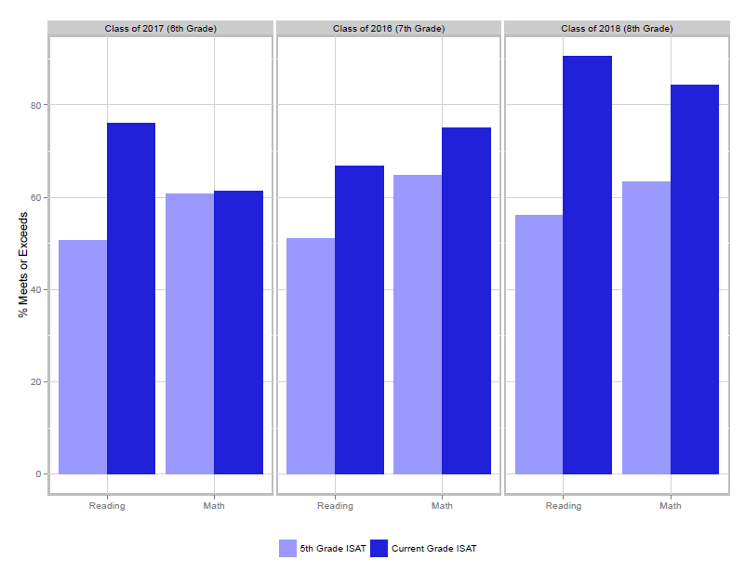
Academic Results
Are our children progressing and achieving academically?
Class of 2017 (6th grade)
Class of 2016 (7th grade)
Class of 2015 (8th grade)
91%
84%
76%
75%
67%
70%
70%
65%
64%
65%
66%
63%
61%
62%
61%
57%
58%
56%
52%
51%
54%
48%
51%
47%
CPS cohort data in red. Source CPS Office of Performance ISAT over time data tables published 8/30/11

Slide 4
Are Our Alumni Climbing the Mountain To and Through College?
 | Class of 2011 | Class of 2012 | Classes of 2011 & 2012 Combined
Graduation Rate | 96% (49/51) | 86% (50/58) | 91% (99/109)
College Matriculation Rate | 88% (45/51) | 76% (45/58) | 83% (95/109)
College Persistence Rate | 86% (44/51) | 76% (44/58) | 81% (88/109)

Slide 5
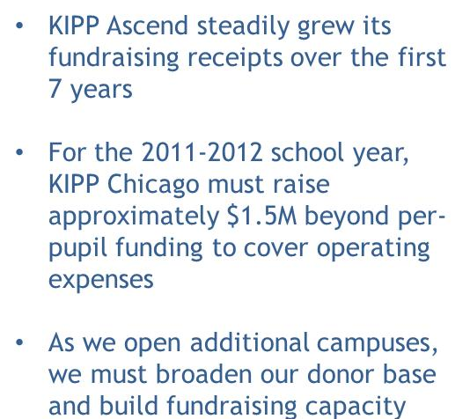
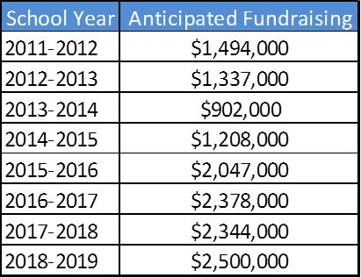
Are we building a sustainable financial model?

Slide 6
KIPP Chicago
School Leader Needs at a Glance

Slide 7
Fundraising

Slide 8
From 2 Schools to 12 Schools
School Year | 2011-2012 | 2012-2013 | 2021-2022
# Schools | 2 | 3 | 12
# Students | 550 | 749 | 5,097
School Operating Suplus/(Deficit) | ($266,674) | ($305,945) | ($1,118,617)
Shared Service Center Expense | ($1,450,468) | ($1,470,621) | ($2,717,153)
Total Deficit | ($1,717,142) | ($1,776,566) | ($3,835,770)
Total Deficit per Student | ($3,122) | ($2,411) | ($753)
Operating Surplus/(Deficit) per School | ($133,337) | ($101,982) | ($93,218)
Total Deficit per School | ($858,571) | ($592,189) | ($319,648)

Slide 9
2012 MAP and ISAT Math Results
MAP
ISAT
Goal
80%

Slide 10
2012 MAP and ISAT Reading Results
MAP
ISAT
Goal
80%

Slide 11
2012 MAP and ISAT Results
MAP
ISAT
Goal
80%

